Slide 1
Memory Management

Slide 2
Content
Background
Swapping
Contiguous Memory Allocation
Paging
Structure of the Page Table
Segmentation
Example: The Intel Pentium
OPERATINGSYSTEM

Slide 3
Introduction
1
Let’s start with the first set of slides

Slide 4
Objectives
To provide a detailed description of various ways of organizing memory hardware
To discuss various memory-management techniques, including paging and segmentation
To provide a detailed description of the Intel Pentium, which supports both pure segmentation and segmentation with paging

Slide 5
Background
Memory consists of a large array of words or bytes, each with its own address.
The CPU fetches instructions from memory according to the value of the program counter. These instructions may cause additional loading from and storing to specific memory addresses.
Memory unit sees only a stream of memory addresses. It does not know how they are generated.
Program must be brought into memory and placed within a process for it to be run.
Input queue – collection of processes on the disk that are waiting to be brought into memory for execution.
User programs go through several steps before being run.

Slide 6
Background(cont…)
Program must be brought (from disk) into memory and placed within a process for it to be run
Main memory and registers are only storage CPU can access directly
Register access in one CPU clock (or less)
Main memory can take many cycles
Cache sits between main memory and CPU registers
Protection of memory required to ensure correct operation

Slide 7
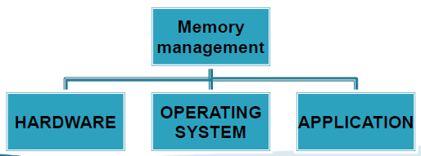
Memory management is a complex field of computer science & there are many techniques being developed to make it more efficient. In the OS memory must be allocated to user program & reused by other programs when it is no longer required. Memory management is divided in to three areas:

Slide 8
HARDWARE memory management: Memory management at the hardware level is concerned with the electronic devices that actually stored data. This includes thing like RAM & memory caches.
OPERATING SYSTEM memory management: In the OS,memory must be allocated to user programs, and reused by other programs when it is no longer required. The OS can pretend that the computer has more memory than it actually does, and also that each program has machine‘s memory to itself; both of these are features of virtual memory system.

Slide 9
APPLICATON memory management :Application memory management involves supplying the memory needed for a program‘s object and data structure from the limited resources available, and recycling that memory for reuse when it is no longer required. Because application programs cannot in general predict in advance how much memory they are going to require, they need addition code to handle there changing memory requirements.

Slide 10
Functions
STATUS:-Keeping the status of each memory location, whether it is allocated or free.
POLICY OF ALLOCATION:-It keep track of how much, where & when the memory should be allocated to the process.
MEMORY ALLOCATION:-When a process request for memory, specific locations must be selected and allocated as per policy above and memory status information is updated correspondingly.
DEALLOCATION:-The allocation memory may be either reclaimed by memory management. This operation is based on the deallocation policy. After deallocation the status information must be updater

Slide 11
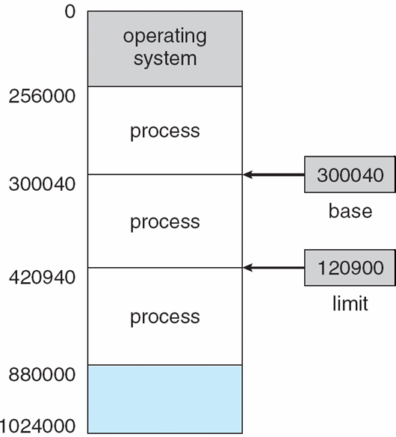
Base and Limit Registers
A pair of base and limit registers define the logical address space
To ensure protection of access of OS programs by user processes and also to protect user processes from
accessing one another, appropriate hardware must be used.
Each process has a separate memory space. To do this, we need the ability to determine the range of legal addresses that the processes may access and to ensure that the process can access only these legal addresses, 2 registers called base and limit are used.
Base register holds the smallest legal physical memory address;
limit register specifies the size of the range.

Slide 12
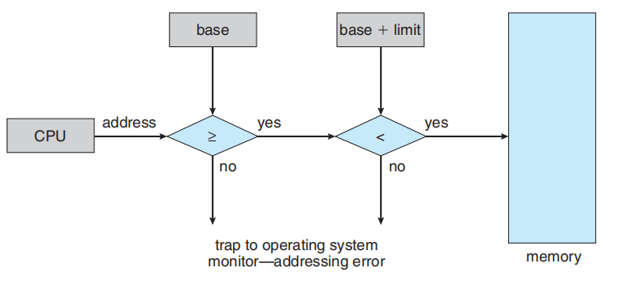
Hardware address protection with base and limit registers.

Slide 13
The CPU hardware compare every address generated in user mode with the registers. Any attempt by a program executing in user mode to access operating system memory or other users‘ memory results in a trap to the OS which treats the attempt as a fatal error.
This prevents a user program from accidentally modifying the code or data structures of OS or other users.
The base and limit registers can be loaded only by the OS, which uses a special instruction in kernel mode. Hence only OS has access to these registers.

Slide 14
Requirement of memory management
Address binding
Dynamic binding
Dynamic linking
Logical and physical address space
Overlays

Slide 15
A program is normally saved on disk as binary file. To execute it has to be brought into memory and placed within the process.
Depending on the memory management in use, the process may moved between the disk and memory during execution.
Normal procedure is to select one of the process in the input Q and to load that in to memory.
User program goes through several steps before being executed (fig)
Addresses may be represented in different ways
Addresses in the source program are generally symbolic(like count). A compiler will bind these addresses to relocatable addresses(such as “14 bytes from beginning of this module” )

Slide 16
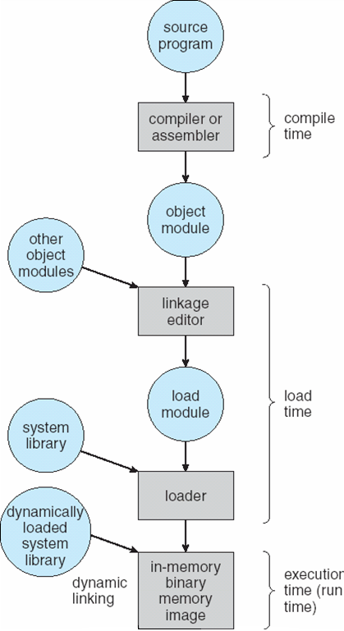
Multistep Processing of a User Program

Slide 17
Binding of Instructions and Data to Memory
Address binding of instructions and data to memory addresses can happen at three different stages
Compile time: If memory location known a priori, absolute code can be generated; must recompile code if starting location changes
Load time: Must generate relocatable code if memory location is not known at compile time
Execution time: Binding delayed until run time if the process can be moved during its execution from one memory segment to another. Need hardware support for address maps (e.g., base and limit registers)

Slide 18
Dynamic Loading
The entire program and all data of a process must be in physical memory for the process to execute.
The size of process is thus limited to the size of physical memory
To obtain better memory space utilization, dynamic loading can be use
Routine is not loaded until it is called. All routines are stored on the disk in a relocatable load format.
The main program is loaded into memory and executed.

Slide 19
Dynamic Loading
When a routine needs to call another routine
Calling routine first checks to see whether the other routine has been loaded
If not, the re locatable linking loader is called to load the desired routine into memory and to update the program’s address tables to reflect this change
Then the control is passed to the newly loaded routine

Slide 20
Dynamic Loading
Advantages
Better memory-space utilization; unused routine is never loaded
Useful when large amounts of code are needed to handle infrequently occurring cases
No special support from the operating system is required implemented through program design

Slide 21
Dynamic Linking
Some O S supports static linking in which system language libraries are treated like any other object module and are combined by the loader into the binary program
The concept of dynamic linking is similar to dynamic loading except that Linking postponed until execution time
This feature is used with system libraries, such as language subroutines libraries. Without this facility each program must include a copy of its language library which wastes both disk space and memory space

Slide 22
Dynamic Linking conti.
With dynamic linking, Small piece of code, stub, used to locate the appropriate memory-resident library routine
When a stub is executed, it checks to see whether the needed routine is already in memory, if not the program loads routine into memory.
Either way, Stub replaces itself with the address of the routine, and executes the routine

Slide 23
Advantages
Dynamic linked libraries are updated at one place
All process using a language library execute only one copy of the library code.
Dynamic linking is particularly useful for libraries System also known as shared libraries
Dynamic linking requires Operating system needed to check if routine is in processes’ memory address

Slide 24
Logical vs. Physical Address Space
The concept of a logical address space that is bound to a separate physical address space is central to proper memory management
Logical address – generated by the CPU; also referred to as virtual address
Physical address – address seen by the memory unit
Logical and physical addresses are the same in compile-time and load-time address-binding schemes;
logical (virtual) and physical addresses differ in execution-time address-binding scheme

Slide 25
The set of all logical address generated by a process is logical address space,
the set of all address corresponding to these logical addresses is physical address space
The runtime mapping from virtual to physical memory address is done by h/w device called memory management unit(MMU)

Slide 26
Memory-Management Unit (MMU)
Hardware device that maps virtual to physical address at run time.
The base register now called as relocation resister.
In MMU scheme, the value in the relocation register is added to every address generated by a user process at the time it is sent to memory
Physical = logical address space + content of the
Address relocation register The user program deals with logical addresses; it never sees the real physical addresses

Slide 27
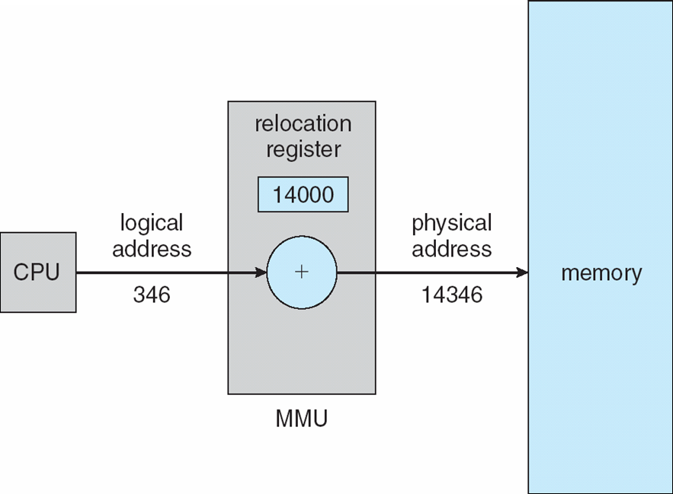
Dynamic relocation using a relocation register

Slide 28
Swapping
A process can be swapped temporarily out of memory to a backing store, and then brought back into memory for continued execution
Backing store – fast disk large enough to accommodate copies of all memory images for all users; must provide direct access to these memory images
Roll out, roll in – swapping variant used for priority-based scheduling algorithms; lower-priority process is swapped out so higher-priority process can be loaded and executed
Major part of swap time is transfer time; total transfer time is directly proportional to the amount of memory swapped
Modified versions of swapping are found on many systems (i.e., UNIX, Linux, and Windows)
System maintains a ready queue of ready-to-run processes which have memory images on disk

Slide 29
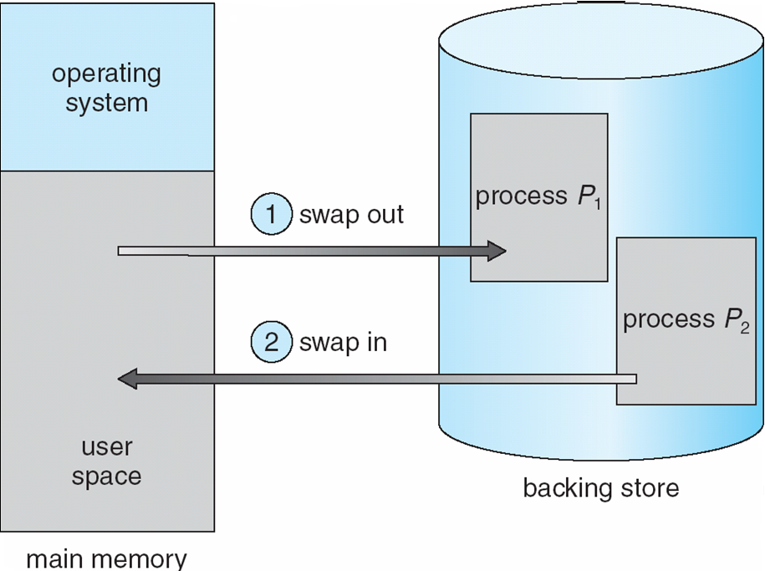
Schematic View of Swapping

Slide 30
Contiguous Allocation
Main memory usually divided into two partitions:
Resident operating system, usually held in low memory with interrupt vector
User processes then held in high memory In this method, when a partition is free, a process is selected from the input queue and is loaded into the partition. When process terminates, the partition becomes available for another.
Initially all the memory is available for user processes and is considered one large block of available memory called hole

Slide 31
Multiple fixed partitions
Initially all the memory is available for user processes and is considered one large block of available memory called hole.
When process arrives and needs memory, we search for a hole large enough to hold the process. If found, it is allocated as much as memory is needed

Slide 32
Contiguous Allocation (Cont)
Hole – block of available memory; holes of various size are scattered throughout memory
When a process arrives, it is allocated memory from a hole large enough to accommodate it
Operating system maintains information about: a) allocated partitions b) free partitions (hole)
OS
OS
OS
OS
process 5
process 5
process 5
process 5
process 9
process 9
process 8
process 10
process 2
process 2
process 2
process 2

Slide 33
Dynamic Storage-Allocation Problem
How to satisfy a request of size n from a list of free holes
First-fit: Allocate the first hole that is big enough
Best-fit: Allocate the smallest hole that is big enough; must search entire list, unless ordered by size
Produces the smallest leftover hole
Worst-fit: Allocate the largest hole; must also search entire list
Produces the largest leftover hole
First-fit and best-fit better than worst-fit in terms of speed and storage utilization

Slide 34
Limitations of fixed partitions
No process can exceed the size of the largest partition
Does not support dynamic data structures
Limits the degree of multiprogramming to the no of partitions

Slide 35
Example of fixed partition
when process A requires 5kb, the O S uses 2 4KB blocks to satisfy.
In this case, the 3kb of leftover memory wont be used.
This wasted memory is said to be caused by internal fragmentation because wasted memory is internal to the memory allocated by the requesting process.

Slide 36
Dynamic partitions
The main drawback of fixed partition is the wastage of memory by programs due to internal fragmentation.
To over come this problem, dynamic or variable partitions are created.
In dynamic partitions, the entire memory is treated as one partition. It creates partitions dynamically according to the size of requesting process.
When a process terminates or swaps out, the memory manager returns the vacated space to the pool of free memory.
Memory manager continues to create and allocate partitions to processes until all physical memory is exhausted

Slide 37
Example Dynamic Partitioning
Operating
System
128 K
Operating
System
Operating
System
Process 1
320 K
Process 1
320 K
Process 2
224 K
896 K
576 K
352 K

Slide 38
Example Dynamic Partitioning
Operating
System
Operating
System
Operating
System
Process 1
320 K
Process 1
320 K
Process 1
320 K
224 K
224 K
Process 4
128 K
Process 2
96 K
Process 3
288 K
Process 3
288 K
Process 3
288 K
64 K
64 K
64 K

Slide 39
Operating
System
Operating
System
320 K
Process 2
224 k
96 K
Process 4
128 K
Process 4
128 K
96 K
96 K
Process 3
288 K
Process 3
288 K
64 K
64 K
The ex. Illustrate the external fragmentation, it exists when the size of memory is large enough for requesting process, but can not accommodate the process since it in not contiguous.

Slide 40
Advantages
Efficient usage of memory and CPU
As there is no limit on no of partitions, higher degree of multiprogramming can me achieved.
Memory allocation algorithms easy to implement
Since portions change dynamically no internal fragmentation
Economic

Slide 41
Disadvantage
Memory allocation and deallocation may lead to external fragmentation.
Fragmentation lead to lower memory utilization
Memory may contain unnecessary informat

Slide 42
Fragmentation
External Fragmentation – total memory space exists to satisfy a request, but it is not contiguous
In extreme case, there may be a block of free memory between every two processes.
Internal Fragmentation – allocated memory may be slightly larger than requested memory; this size difference is memory internal to a partition, but not being used.
Consider a hole of 18,646 b, suppose next process is 18462 b, now a hole with 2 byte are left
The over head to keep the track of this hole will substantially larger than the hole itself.

Slide 43
Fragmentation can be reduced by
Compaction
Paging
Segmentation

Slide 44
Compaction
The goal of compaction is to Shuffle memory contents to place all free memory together in one large block
Compaction is possible only if relocation is dynamic, and is done at execution time
If relocation is dynamic, it requires only moving the program and data, and then changing the base register to reflect the new base resister.
Simplest compaction is to move all processes towards one end of memory.
Which leads all holes move in other direction producing on large hole. This scheme is expensive

Slide 45
OS
OS
OS
P1
P1
P1
P2
P3
P3
P2
P2
P3
Compaction is not possible always, is static relocation is done at load time, compaction is not possible.
compaction is usually not preferred since it consumes lot of CPU time and is expensive

Slide 46
Advantages
Can be easily implemented
Reduces external fragmentation
Higher degree of multiprogramming can be achived
Increased utilization of resources
Disadvantages
Very time consuming
Requires special hardware for compaction which increases cost
Relocation of addresses is an overhead on O S
Can not be implemented on small machines

Slide 47
Paging
Logical address space of a process can be noncontiguous; process is allocated physical memory whenever the latter is available
Divide physical memory into fixed-sized blocks called frames (size is power of 2, between 512 bytes and 8,192 bytes)
Divide logical memory into blocks of same size called pages
Keep track of all free frames
To run a program of size n pages, need to find n free frames and load program
Set up a page table to translate logical to physical addresses
Internal fragmentation

Slide 48
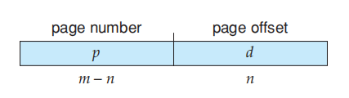
Address Translation Scheme
Address generated by CPU is divided into: Page number (p) – used as an index into a page table which contains base address of each page in physical memory Page offset (d) – combined with base address to define the physical memory address that is sent to the memory unit
For given logical address space 2^{m} and page size 2^{n}

Slide 49
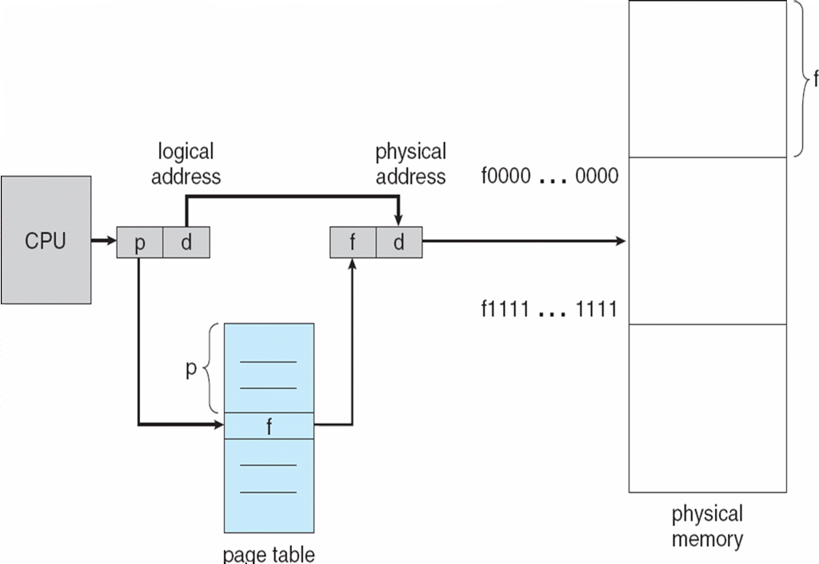
Paging Hardware

Slide 50
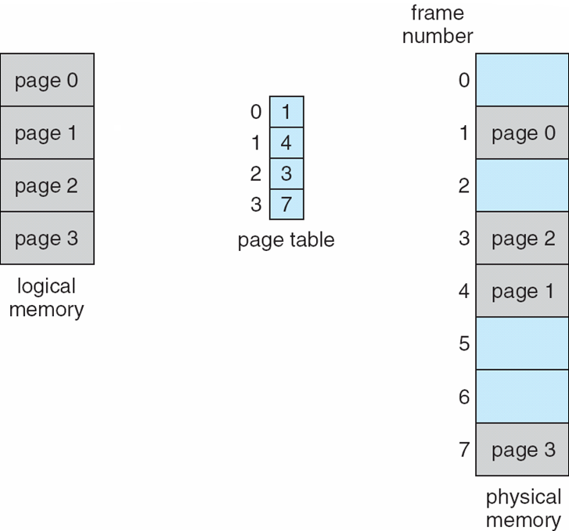
Paging Model of Logical and Physical Memory

Slide 51
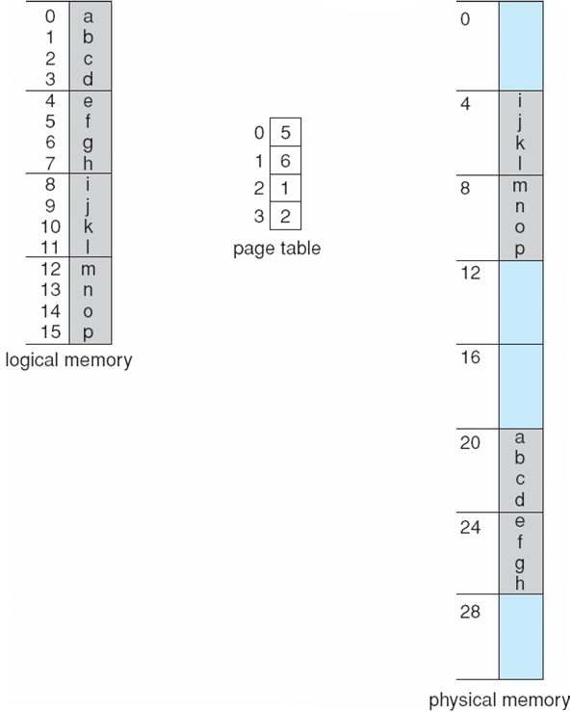
Paging Example
32-byte memory and 4-byte pages

Slide 52
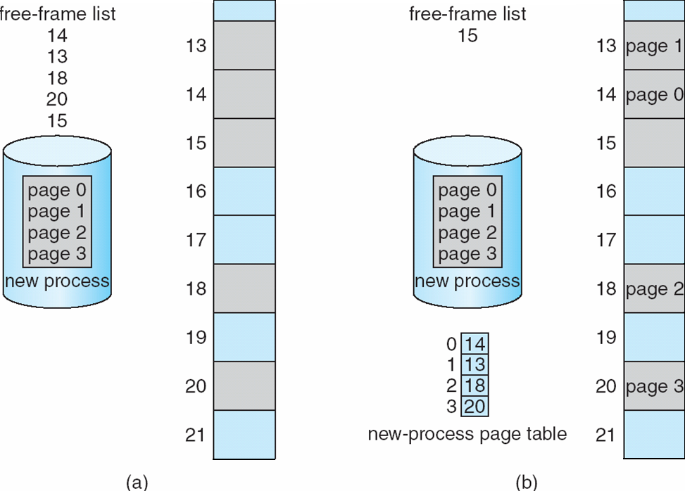
Free Frames
Before allocation
After allocation

Slide 53
Implementation of Page Table
Page table is kept in main memory
Page-table base register (PTBR) points to the page table
Page-table length register (PRLR) indicates size of the page table
In this scheme every data/instruction access requires two memory accesses. One for the page table and one for the data/instruction.
The two memory access problem can be solved by the use of a special fast-lookup hardware cache called associative memory or translation look-aside buffers (TLBs)
Some TLBs store address-space identifiers (ASIDs) in each TLB entry – uniquely identifies each process to provide address-space protection for that process

Slide 54
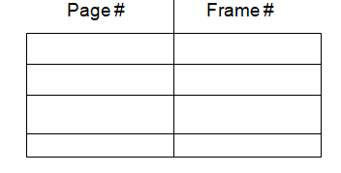
Associative Memory
Associative memory – parallel search
Address translation (p, d)
If p is in associative register, get frame # out
Otherwise get frame # from page table in memory

Slide 55
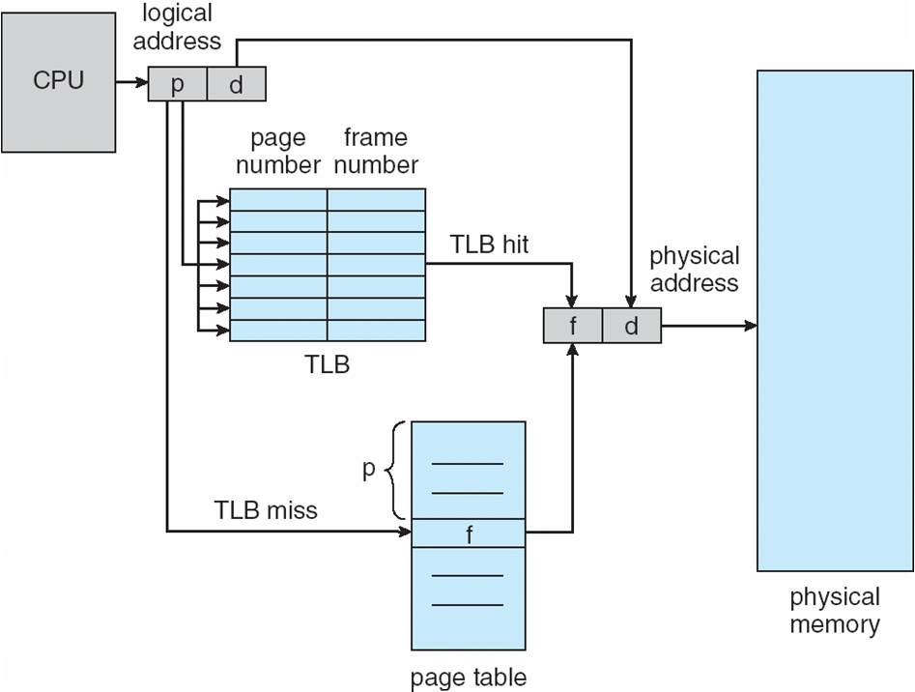
Paging Hardware With TLB

Slide 56
Effective Access Time
Associative Lookup = ε time unit
Assume memory cycle time is 1 microsecond
Hit ratio – percentage of times that a page number is found in the associative registers; ratio related to number of associative registers
Hit ratio = α
Effective Access Time (EAT)
EAT = (1 + ε) α + (2 + ε)(1 – α)
= 2 + ε – α

Slide 57
Adv.
Avoid external fragmentation and hence results in better memory utilization
Supports virtual memory
Supports non contiguous memory allocation
Allows sharing of common code among several processes
Useful in time sharing systems

Slide 58
Dis adv.
Suffers from breaks resulting in internal fragmentation
Difficult to maintain page tables when number of pages increases
Hardware cost is high
Increase in context switch

Slide 59
Segmentation
Memory-management scheme that supports user view of memory
A program is a collection of segments
A segment is a logical unit such as:
main program
procedure
function
method
object
local variables, global variables
common block
stack
symbol table
arrays

Slide 60
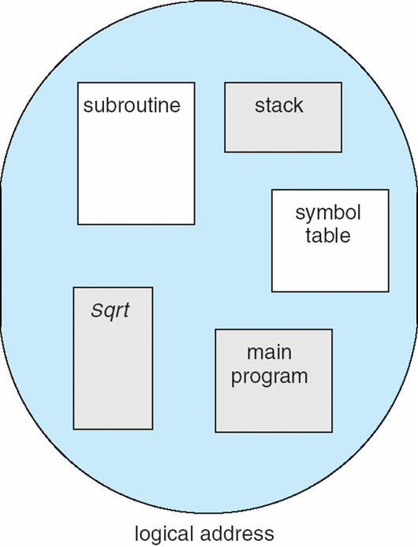
User’s View of a Program

Slide 61
Segmentation is MM scheme that supports users view
Each segment is of different length. Segments are identified by their offset from the beginning of the segment EX: 1st statement in the main program, 6th instruction in function.
Segments are formed at the time of program translation by grouping logically related entities per segment. Formation of segments depend on the compiler. When program is complied, the compiler automatically crates segments of input program

Slide 62
Logical address space is a collection of segments. Each segment has name and length.
The components of a single segment reside in one contiguous area. Different segments of the same process may occupy non- contiguous area of physical memory.
The address specify both segment name and the offset

Slide 63
Logical View of Segmentation
1
1
4
2
3
4
2
3
user space
physical memory space

Slide 64
Logical address consists of a two parts:
<segment-number, offset>,
Segment number (s) -- segment number is used as an index into a segment table which contains base address of each segment in physical memory and a limit of segment.
Segment offset (o) -- segment offset is first checked against limit and then is combined with base address to define the physical memory address.
Memory is allocated dynamically each segment is numbered and segment map table is created for each job.
segment table consists of segment number, their length, access rights, status and their location in memory.

Slide 65
Segmentation Architecture
To map 2 Dimensional user defined address space into 1 Dimensional physical address has to be defined. It is done by segment table
Segment table – maps two-dimensional physical addresses; each table entry has:
base – contains the starting physical address where the segments reside in memory
limit – specifies the length of the segment
Segment-table base register (STBR) points to the segment table’s location in memory
Segment-table length register (STLR) indicates number of segments used by a program;
Segment number s is legal if s < STLR

Slide 66
Segmentation Architecture
Segments are stored in physical memory as shown in fig
The offset d of logical address must be between 0 and segment limit. If it is not, we trap the O S (logical address beyond the end of segment ) when an offset is legal, it is added to the segment base to produce the address in physical memory of the desired byte.
Similar to page table, segment table can be kept in either fast registers or main memory. Incase of large program consisting of large number of segments, it is kept in memory.

Slide 67
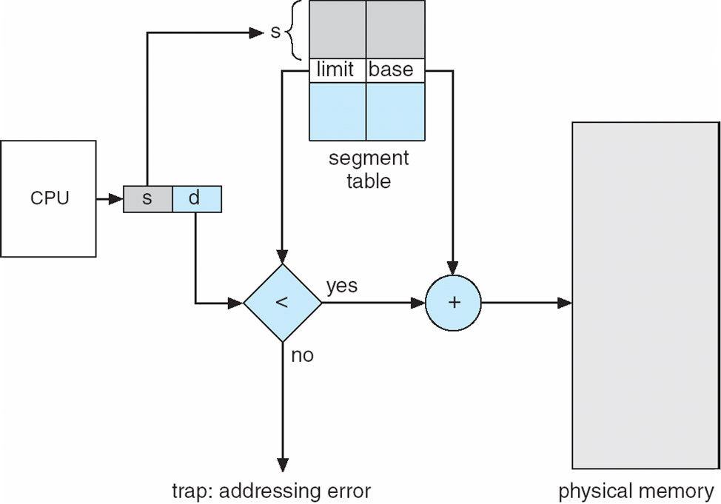
Segmentation Hardware

Slide 68
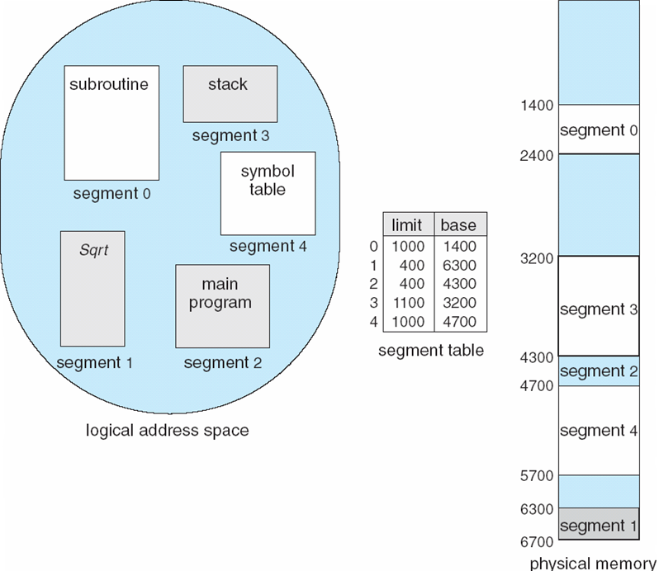
Example of Segmentation

Slide 69
Segmentation Architecture (Cont.)
Protection: Protection of one segment from the other is done using a Protection bit.
With each entry in segment table associate:
validation bit = 0 ⇒ illegal segment
read/write/execute privileges
It could be an attempt to write into a read only segments or to use an execute only segment

Slide 70
Protection bits associated with segments; code sharing occurs at segment level
The memory management h/w checks whether the array indexes are legal and do not cross boundaries
Since segments vary in length, memory allocation is a dynamic storage-a segment associated with a dynamic data structure such as stack, binary tree etc. may increase or decrease in size

Slide 71
Shared segments
Segments are shared when entries in the segment tables of two different processes point to the same physical location as shown in fig
Ex: the Editor is shared by process p1 & p2 by having the same base address in their perspective segment tables and pointing to the same segment. By sharing only one copy of the editor
Parts of the program can be shared such as common libraries if they are defined as sharable and readonly segemnts

Slide 72
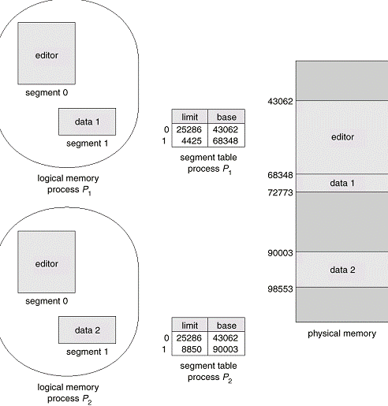

Slide 73
Fragmentation in segmentation
Segmentation may lead to external fragmentation if all the blocks of free memory are too small to fit a segment. In such situation, process must wait until enough memory is available of compaction creates a larger hole
external fragmentation depends on average segment size
If average segment size is small external fragmentation also will be small

Slide 74
Adv and Dis Adv
Adv
Allows sharing amongst various processes using the same piece of code
Supports modular programming
Provides protection mechanism using protection bit
Allow dynamic growing of segments
Dis Adv
Segments must be contiguous
Can lead to external fragmentation
Implementation cost is high

